Slide 1

Update on Ceramic Conformal Printing
Bipendra Basnet-7/12/2021

Slide 2
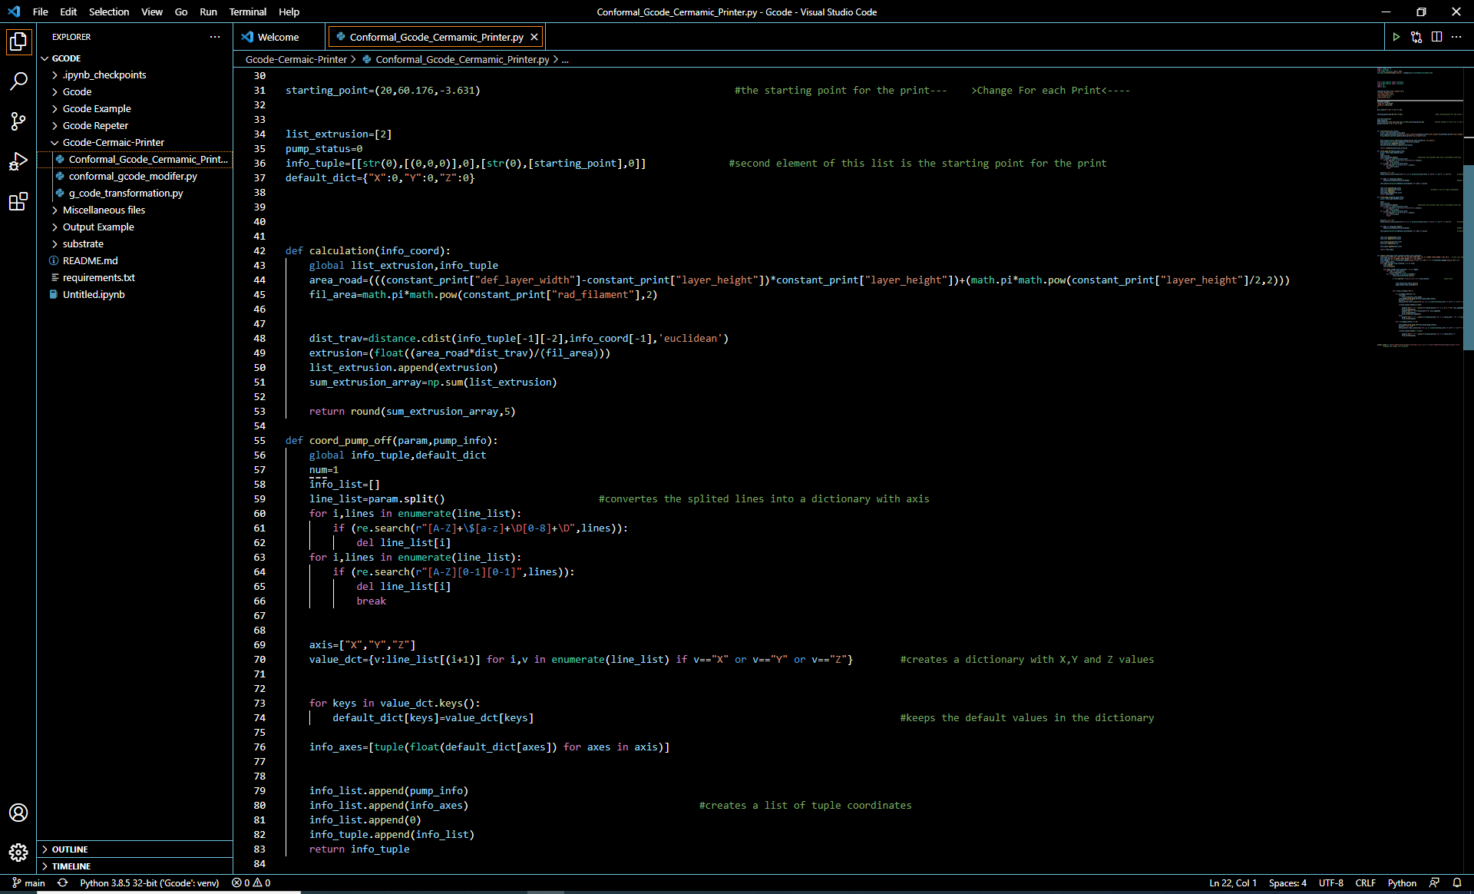
Program for Gcode for Ceramic Printer

Slide 3
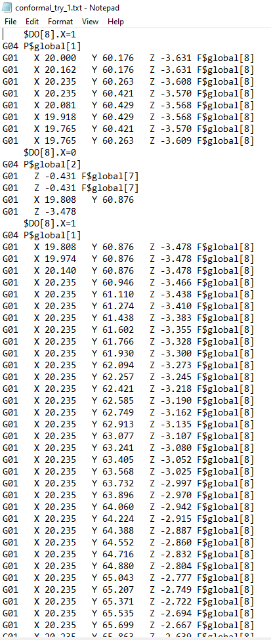
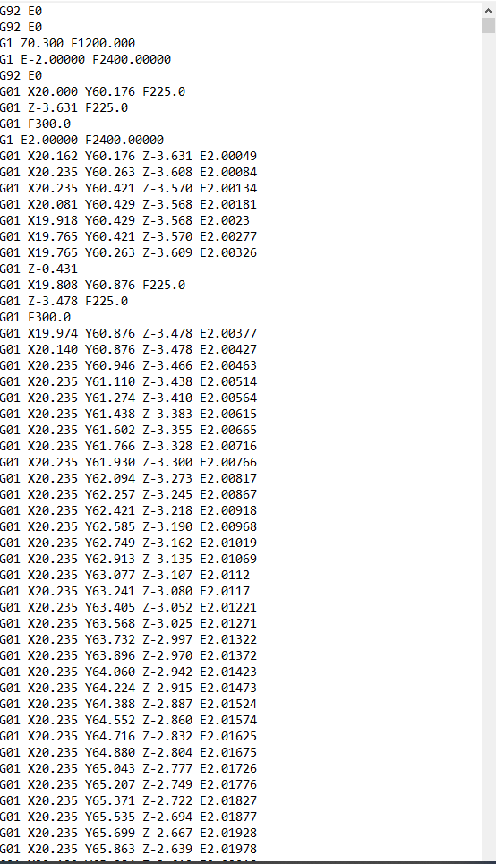
Input and Output
Output:
Output contains calculated Extrusion values for the Ceramic Printer.
Input
Output

Slide 4
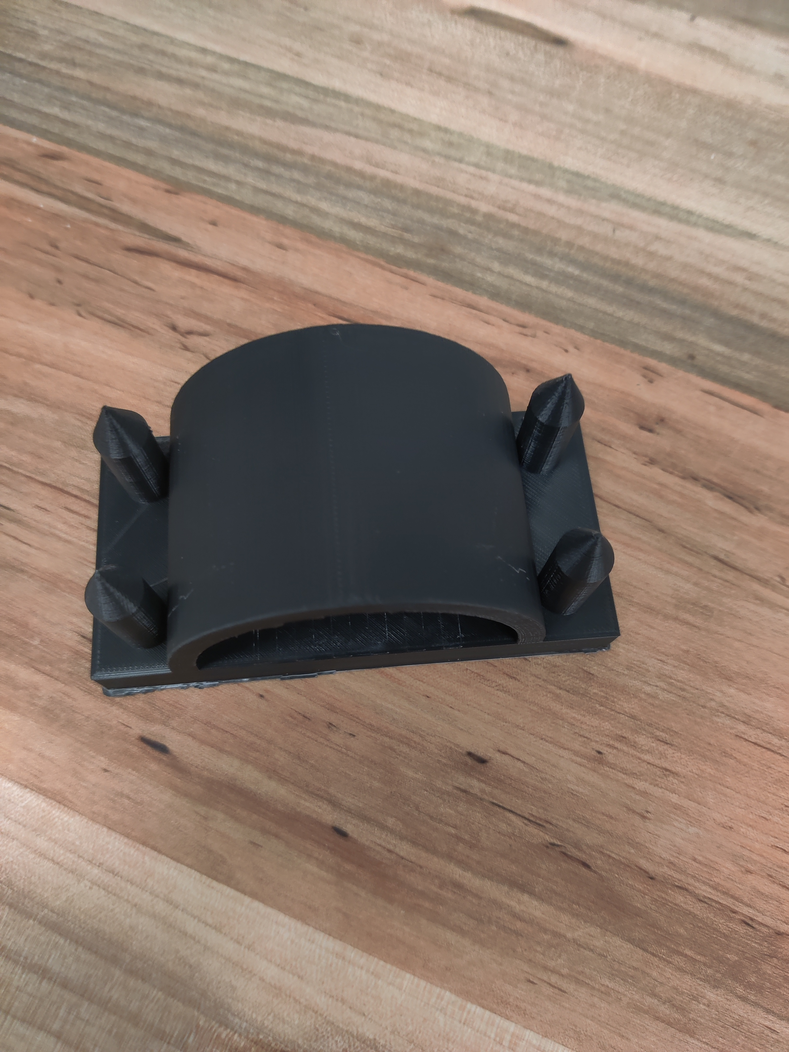
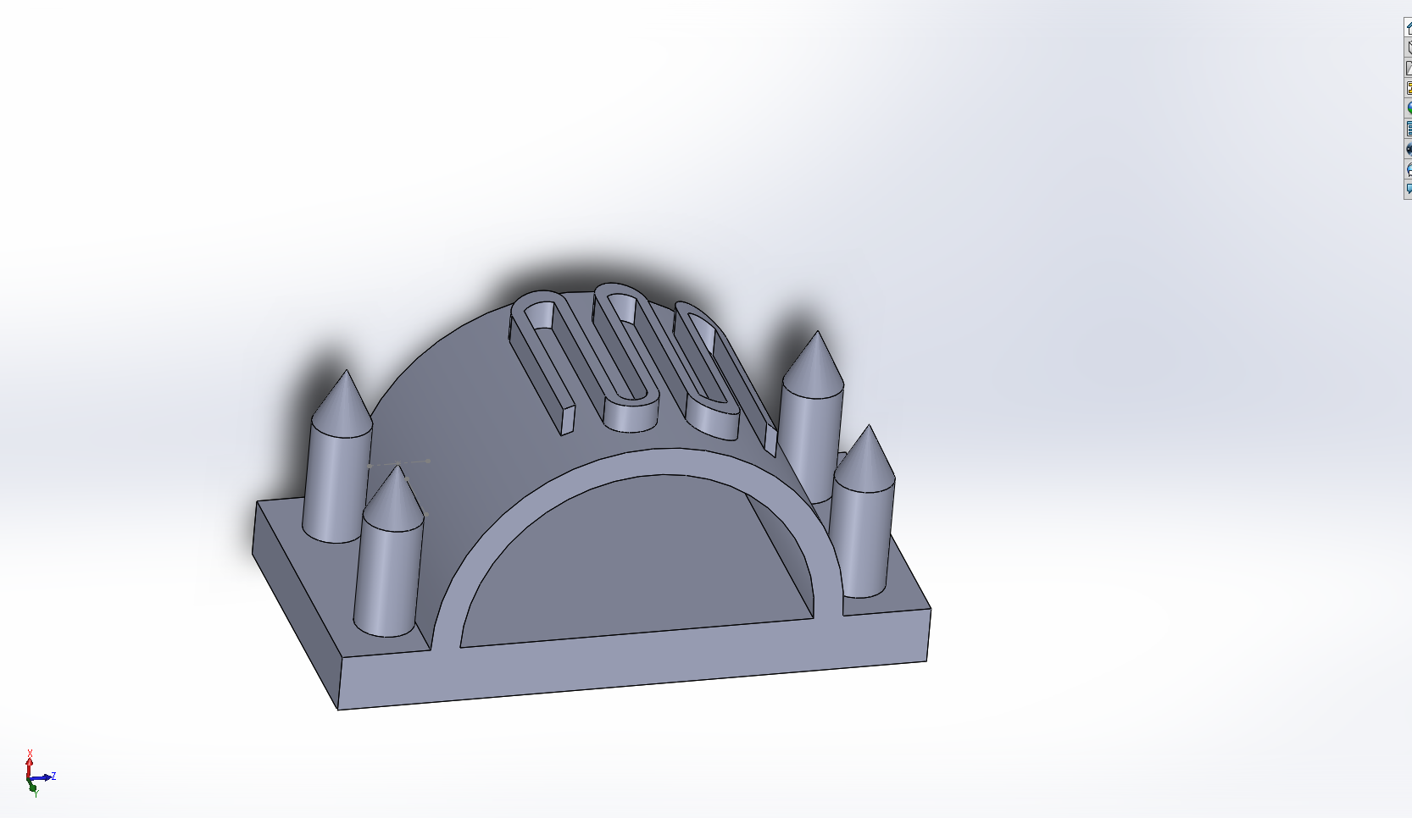
Trial Print
Printed Substrate on Ultimaker

Slide 5
Next Objective
Do trial runs of conformal print on Ceramic Printer.
Based on trial run modify the G-code.
Literature review and use of long tip extruder.

